Slide 1


Slide 2
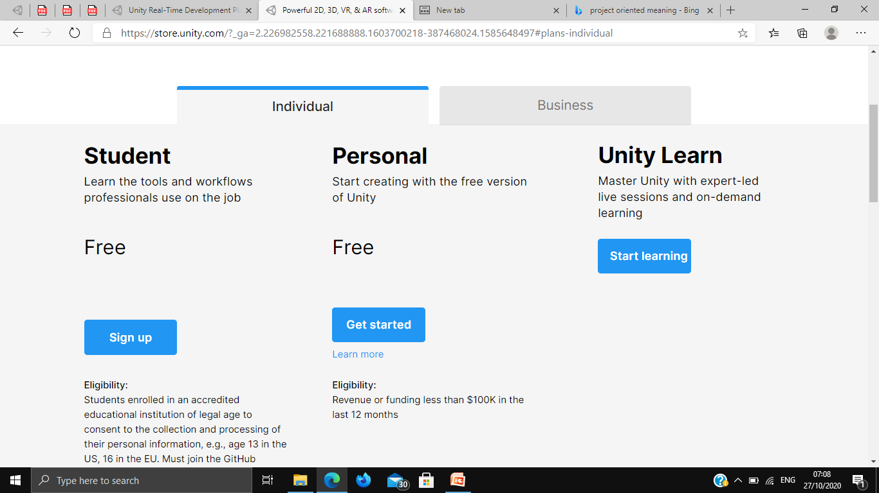
INTRODUCTION unity3d.com.

Slide 3
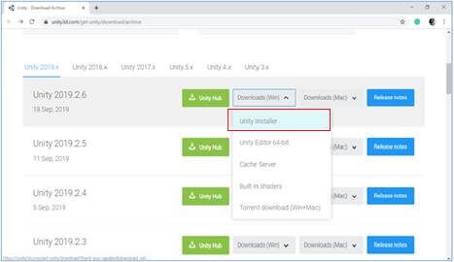
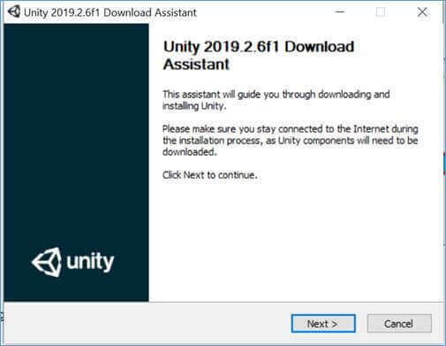
Installing Unity

Slide 4
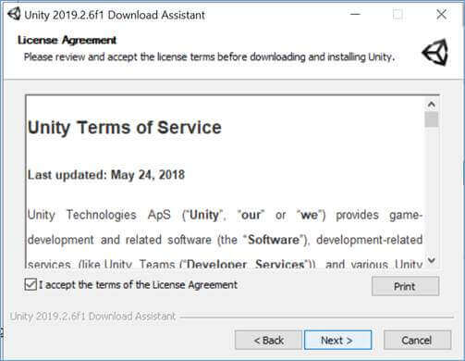
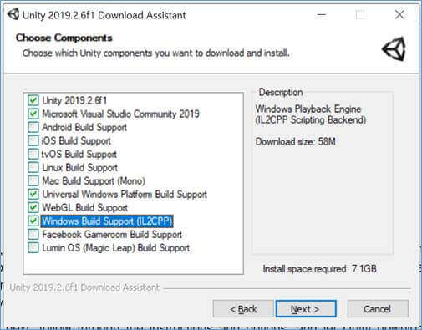

Slide 5
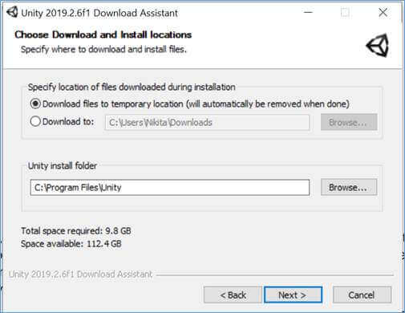
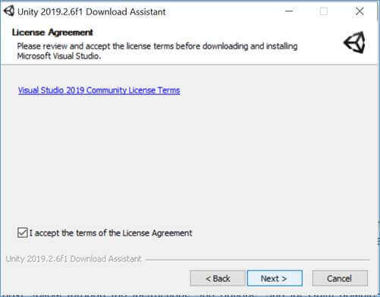

Slide 6
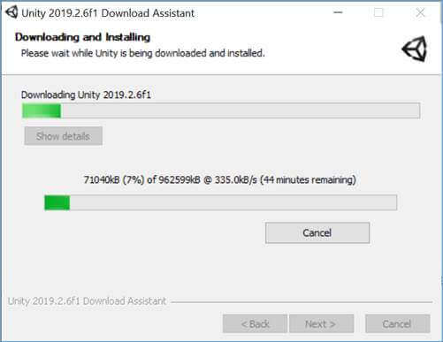

Slide 7
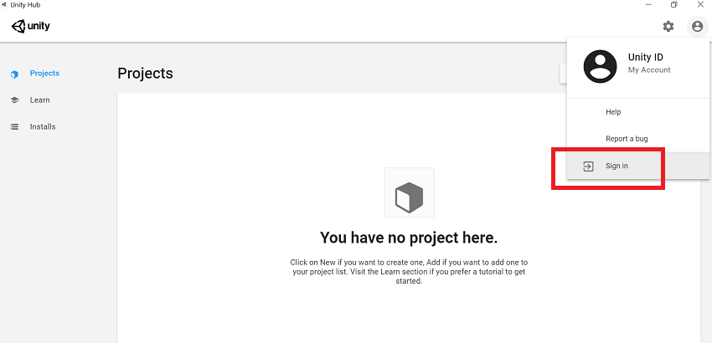
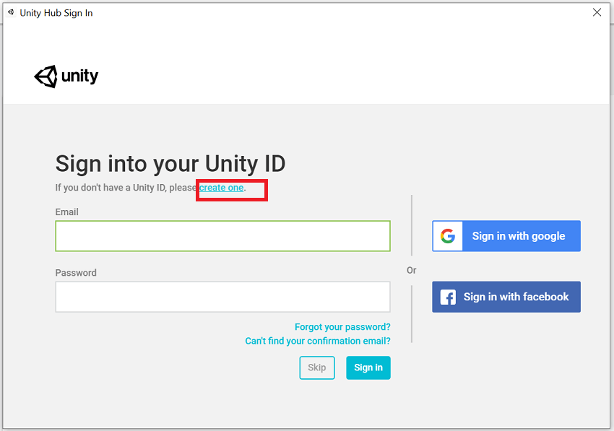
Creating a Unity Account

Slide 8
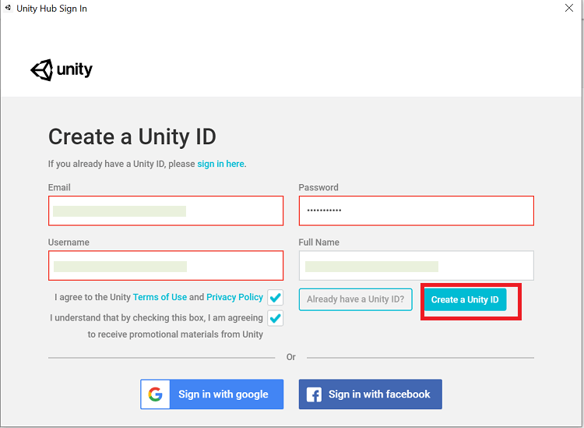
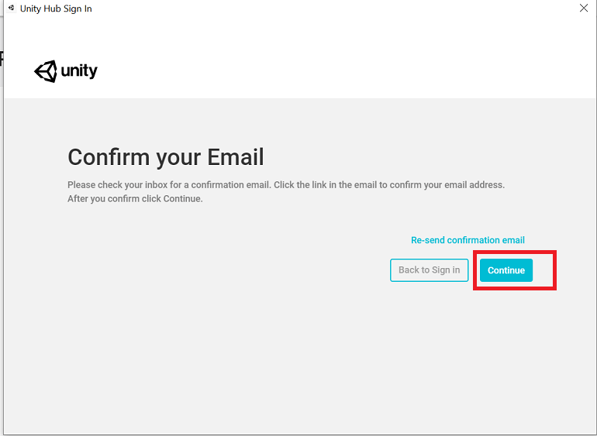

Slide 9
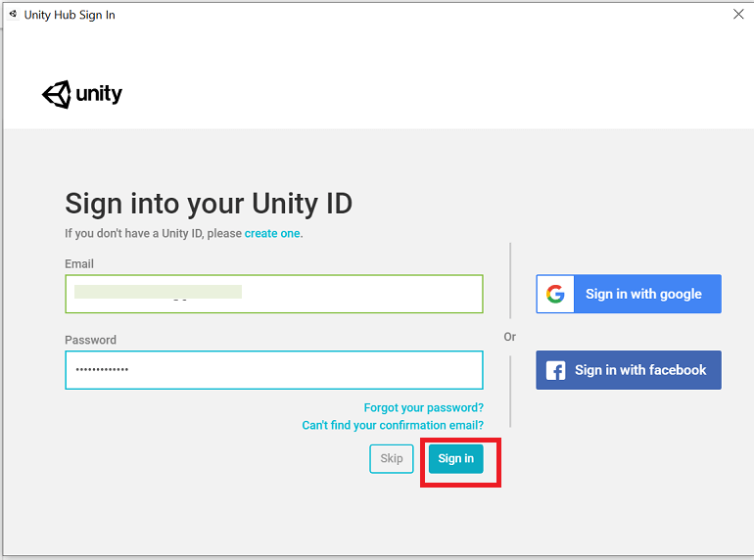

Slide 10
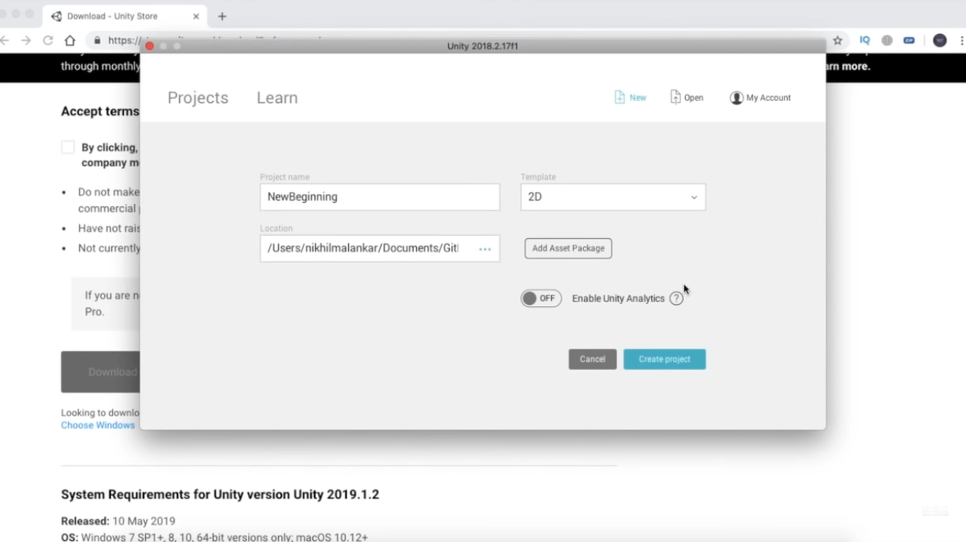
Unity’s interface

Slide 11
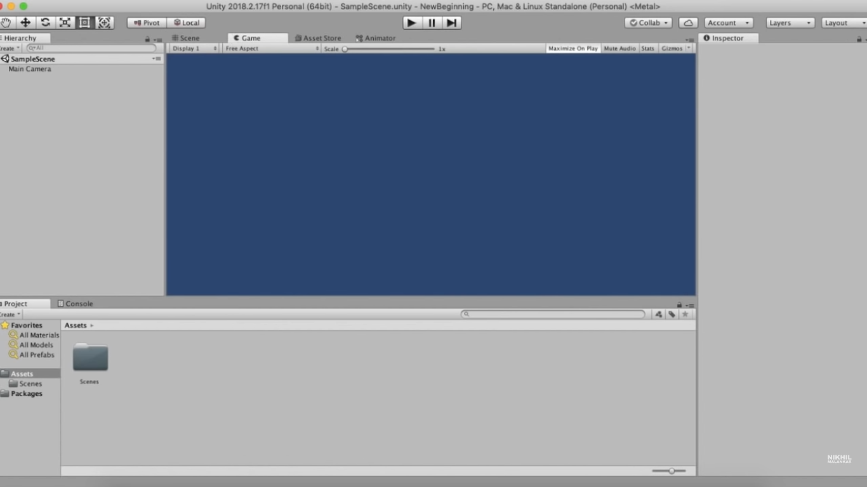

Slide 12
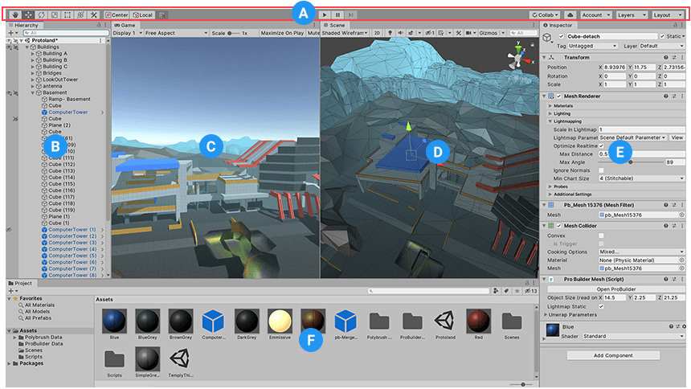

Slide 13
User Interface(UI)
Unity UI (User Interface) is used to create a user interface in your game or application.
the workflow for designing Unity UI follows a slightly different path than the one we have been going through so far. For starters, UI elements are not standard GameObjects and can't be used as such.
UI elements are designed differently; UI elements are designed differently; a menu button that looks correct in a 4:3 resolution may look stretched or distorted in a 16:9 resolution if not set upright.
In Unity, we cannot place the UI elements directly on the scene. They are always located as children of a special GameObject called the Canvas.
UI CANVAS:-
UI Canvas acts as the master of all UI elements on the screen. Because of that, all UI elements are required to be the child game object of the canvas game object.
To add the canvas in your scene right, click on the Scene name or Main Came and select GameObject -> UI -> Canvas

Slide 14
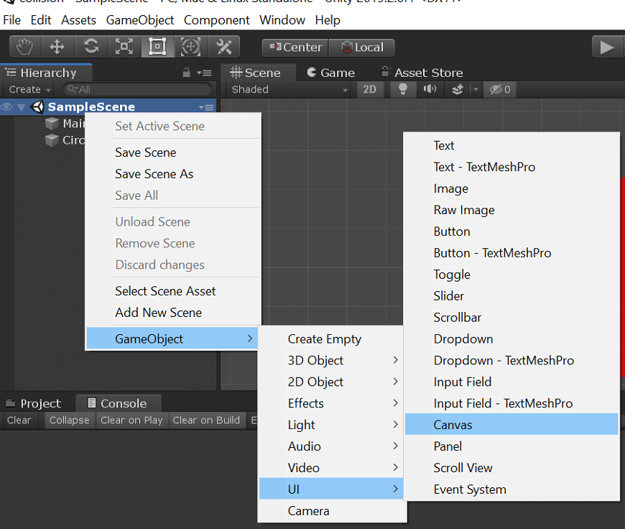
UI Canvas

Slide 15
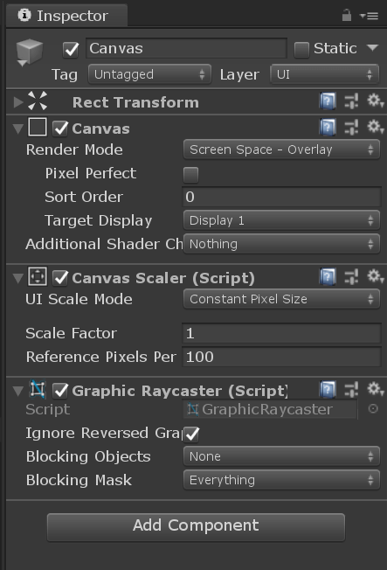
Canvas Components

Slide 16
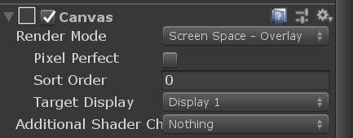
Canvas Component
canvas is the master component that holds a couple of universal options as to how the UI is drawn.
The first prop erty Render Mode defines the method that is used to draw the canvas onto the Game's view.

Slide 17
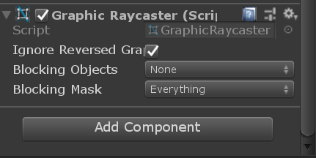
Graphics Raycaster
Graphics Raycaster component deals primarily with raycasting (link to Unity Documentation for Raycasting) the UI elements and ensuring user-initiated events like clicks and drags work correctly.

Slide 18
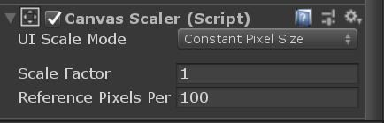
Canvas Scalar
The canvas scalar component is a set of options that allows you to adjust the scale and appearance of the UI elements in a more definitive way.

Slide 19
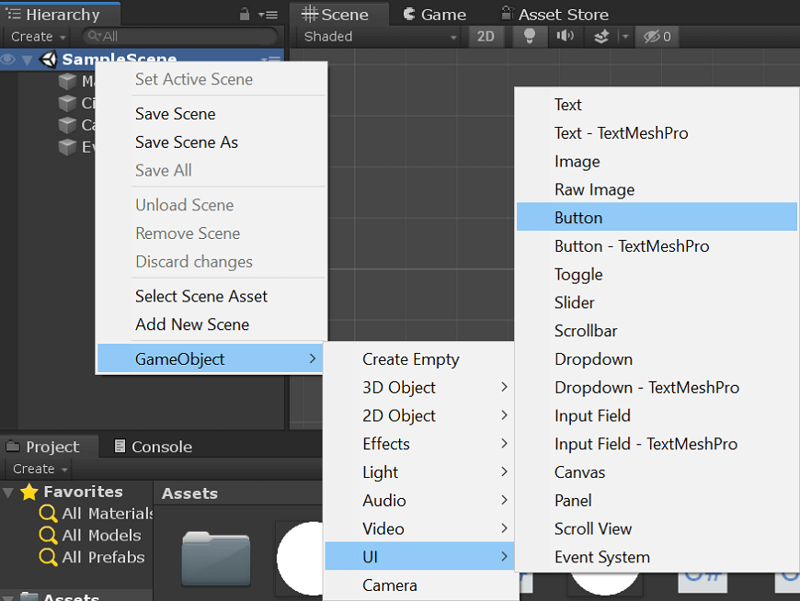
Unity UI Button
Button is used to initiate or confirm an action

Slide 20
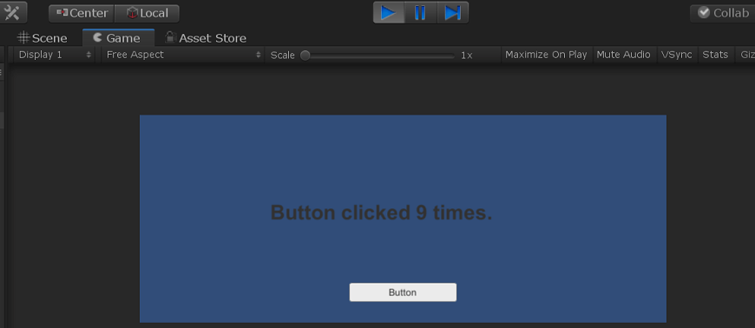
Unity UI Text
Text elements can be used to provide captions or labels for other GUI controls or to display instructions or other text.

Slide 21
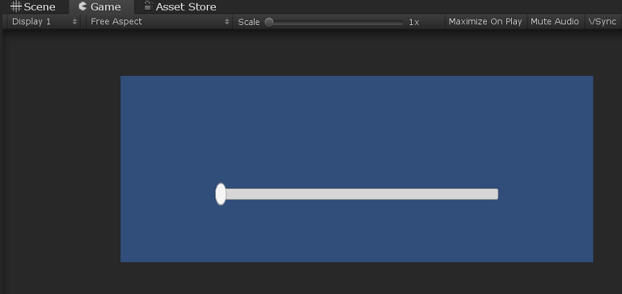
Unity UI Slider
The Slider UI element is commonly used where a certain value should be set between a minimum and maximum value pair. One of the most common usages of this is for audio volume, screen brightness, or for doing zoom.

Slide 22
Graphics
Graphics are visual images or designs on some surface, such as a wall, canvas, screen, paper, or stone to inform, illustrate, or entertain. In contemporary usage, it includes a pictorial representation of data, as in c manufacture, in typesetting and the graphic arts, and in educational and recreational software. Images that are generated by a computer are called computer graphics.

Slide 23
Graphics in Unity
This section explain all the need to know about
Render pipelines
Cameras
Lighting
Meshes
Materials
Shaders
Particle System
Creating Environments
Visual Effect Components

Slide 24
1. RENDER PIPELINES:- In computer graphics, a computer graphics pipeline, rendering pipeline or simply graphics pipeline, is a conceptual model that describes what steps a graphics system needs to perform to render a 3D scene to a 2D screen.
The Built-in Render Pipeline is Unity’s default render pipeline. It is a general-purpose render pipeline that has limited options for customization.
The Universal Render Pipeline (URP) is a Scriptable Render Pipeline that is quick and easy to customize, and lets you create optimized graphics across a wide range of platforms.
The High Definition Render Pipeline (HDRP) is a Scriptable Render Pipeline that lets you create cutting-edge, high-fidelity graphics on high-end platforms.
You can create your own custom Scriptable Render Pipeline (SRP) using Unity’s Scriptable Render Pipeline API. You can do this from scratch, or you can modify URP or HDRP to suit your needs.

Slide 25
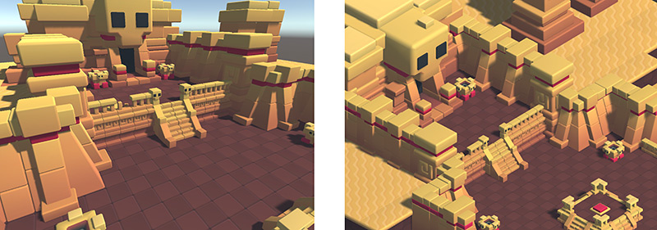
2. CAMERA is an object that defines a view in scene space.
A camera in the real world, or indeed a human eye, sees the world in a way that makes objects look smaller the farther they are from the point of view.
Perspective and Orthographic Cameras

Slide 26
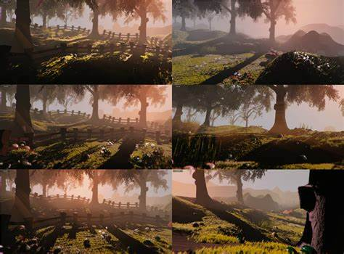
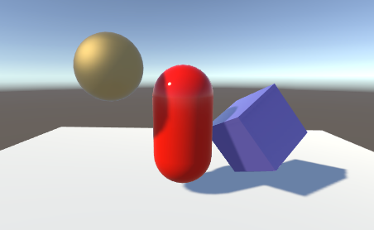
LIGHTING in Unity works by approximating how light behaves in the real world.
Direct and indirect lighting
Real-time and baked lighting
Global illumination
Light Sources
In order to calculate the shading of a GameObject that is affected by lighting, Unity needs to know the intensity, direction, and color of the light that falls on it. This information is provided by light sources.
Shadows:

Slide 27
4. MESHES are the main graphics primitive of Unity. They define the shape of an object.
5. Materials define how a surface should be rendered, by including references to the Textures it uses, tiling information, Color tints and more. The available options for a Material depend on which Shader the Material is using.
6. Shaders are small scripts that contain the mathematical calculations and algorithms for calculating the Color of each pixel rendered, based on the lighting input and the Material configuration.
7. Textures are bitmap images. A Material can contain references to textures, so that the Material’s Shader can use the textures while calculating the surface color of a GameObject.

Slide 28
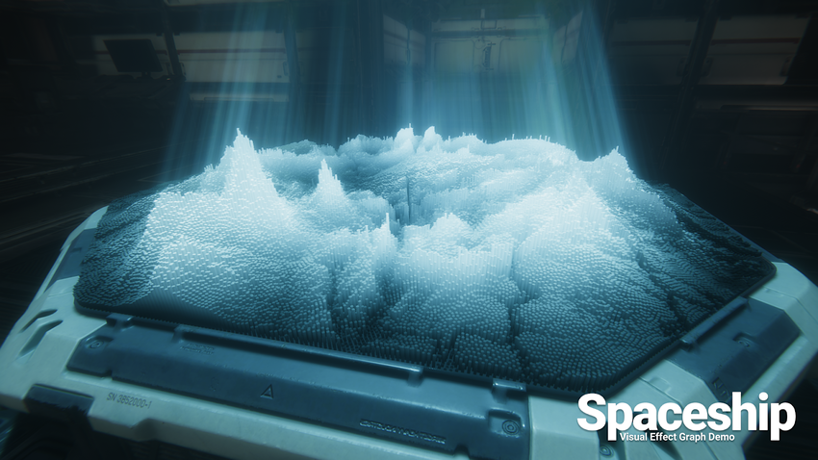
8. Particle systems
A particle system simulates and renders many small images or Meshes, called particles, to produce a visual effect. The system simulates every particle collectively to create the impression of the complete effect.

Slide 29
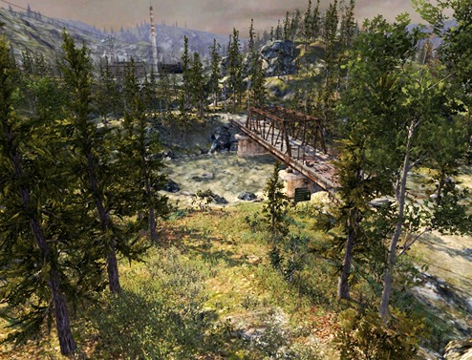
Creating Environment

Slide 30
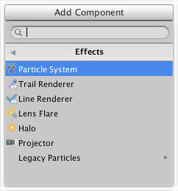
Visual Effects Components
Visual effects can be applied to cameras, GameObjects, light sources, and other elements of your game. This section provides information on the visual effects available in the Unity Editor.
To access the visual effects available in the Unity Editor, select the item in the Hierarchy window that you wish to apply the effect to, then in the Inspector window go to Add Component > Effects.

Slide 31
Physics in Unity
Unity helps you simulate physics in your Project to ensure that the objects correctly accelerate and respond to collisions, gravity, and various other forces.
Built-in physics engines for object-oriented projects-
Built-in 3D physics (Nvidia PhysX engine integration)
Built-in 2D physics (Box2D engine integration)
Built-in 3D physics-
An overview of main concept related to physics Rigidbodies, colliders, Joints and Character Controllers.
Continuous collision detection and multi-scene physics
Physics Debug Visualization-
Physics Debug Visualiser allows you to quickly inspect the Collider geometry in your Scene. It provides a visualisation of which GameObjects should and should not collide with each other. This is particularly useful when there are many Colliders in your Scene.

Slide 32
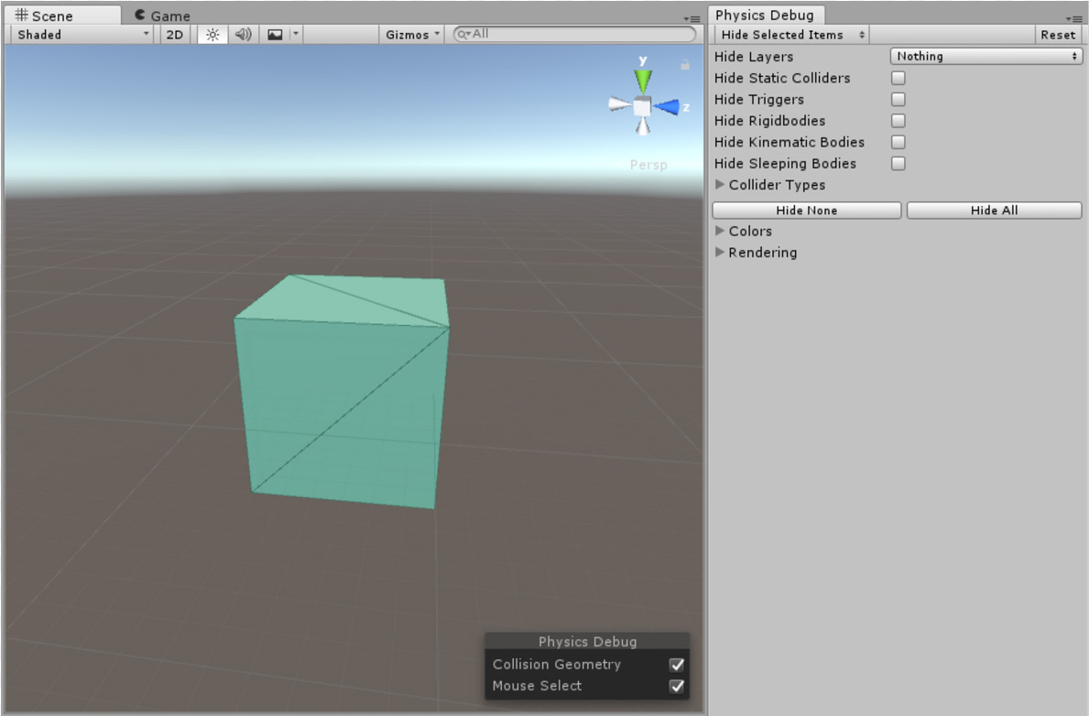
To open the Physics Debug window in the Unity Editor, go to Window > Analysis > Physics Debugger.

Slide 33
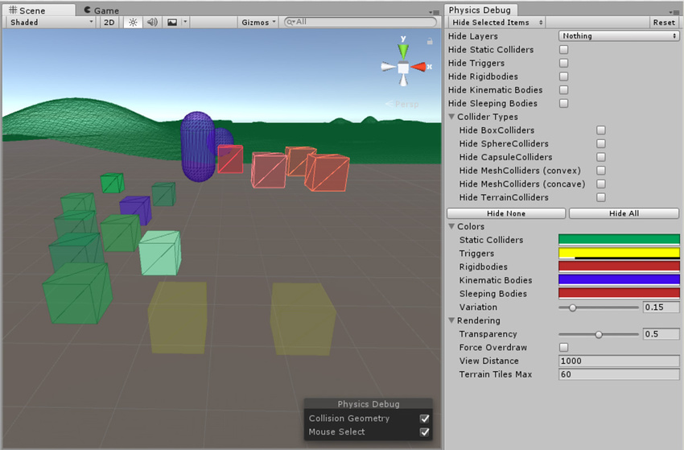

Slide 34
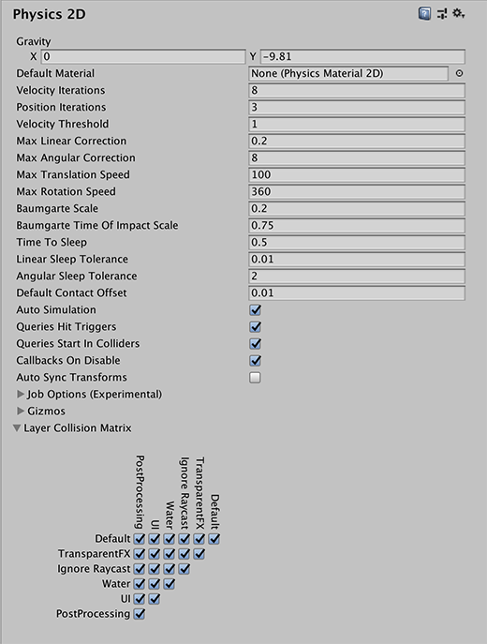
Bulit-in 2D physics

Slide 35
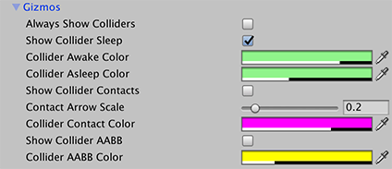

Slide 36
Physics engine packages for data-oriented projects:-
Unity Physics package: the DOTS physics engine you need to install by default to simulate physics in any data-oriented project.
Havok Physics for Unity package: an implementation of the Havok physics engine for Unity, to use as an extension of the Unity Physics package. Note that this package is subject to a specific licensing scheme.
Unity Physics-
Use the Unity Physics package to benefit from a deterministic rigid body dynamics system and spatial query system that uses the Unity data oriented tech stack (DOTS).
You can install a package from the registry only when the scope is set to All packages:
Open the Package Manager window and select All packages
Select the package you want to install from the list of packages.
Select the version to install, click on install button.

Slide 37
Havok Physics for Unity:-
Use the Havok Physics for Unity package to benefit from the Havok Physics engine within Unity.
Havok Physics offers the fastest, most robust collision detection and physical simulation technology available, which is why it has become the gold standard within the games industry and has been used by more than half of the top selling titles this console generation.

Slide 38
3D Physics Reference:-
The components used with 3D physics.
Box Collider
Capsule Collider
Character Controller
Character Joint
Configurable Joint
Constant Force
Fixed Joint
Hinge Joint
Mesh Collider
Rigid body
Sphere Collider
Spring Joint
Cloth
Wheel Collider
Terrain Collider
Physic Material

Slide 39
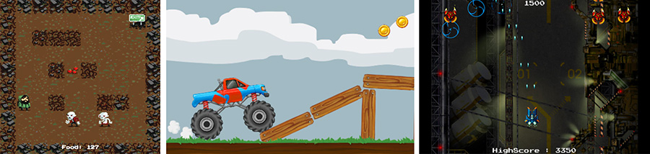
2D
Unity is a cross-platform game engine initially released by Unity Technologies, in 2005.
The focus of Unity lies in the development of both 2D and 3D games and interactive content.
Unity now supports over 20 different target platforms for deploying, while its most popular platforms are the PC, Android and iOS systems.

Slide 40
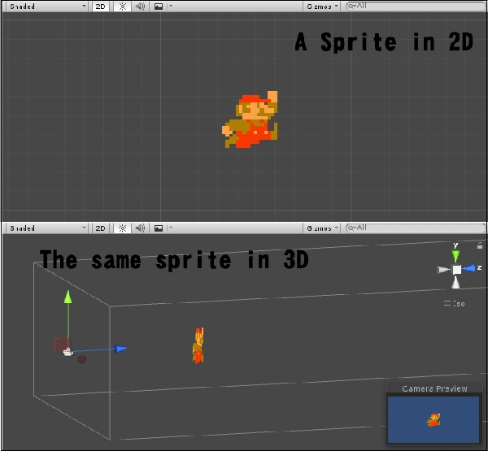
Sprites
Sprites are simple 2D objects that have graphical images (called textures) on them. Unity uses sprites by default when the engine is in 2D mode. When viewed in 3D space, sprites will appear to be paper-thin, because they have no Z-width.

Slide 41
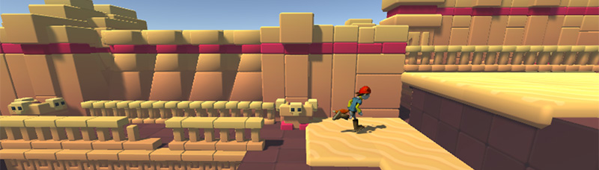
2D gameplay with 3D graphics:-
Some 2D games use 3D geometry for the environment and characters, but restrict the gameplay to two dimensions.
For these games, the 3D effect may serve a stylistic rather than functional purpose.
This type of game is also sometimes referred to as “2.5D”. Although the gameplay is 2D, you are mostly manipulating 3D models to build the game, so you should start the editor in 3D mode.

Slide 42
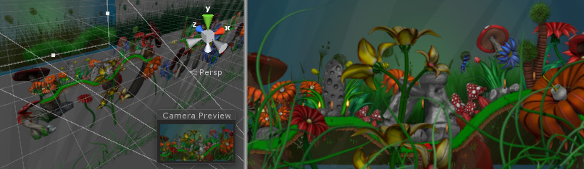
2D gameplay and graphics, with a perspective camera:-

Slide 43
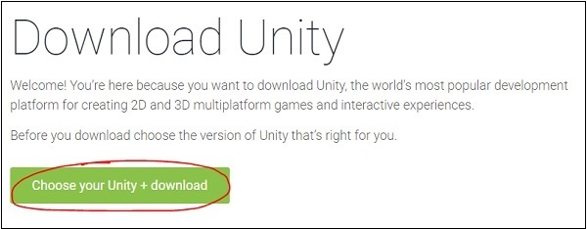
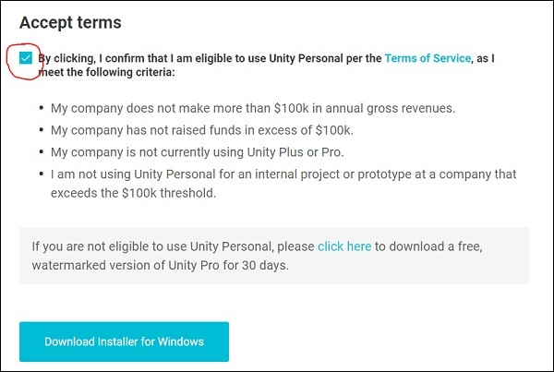
Installation and Setting up

Slide 44
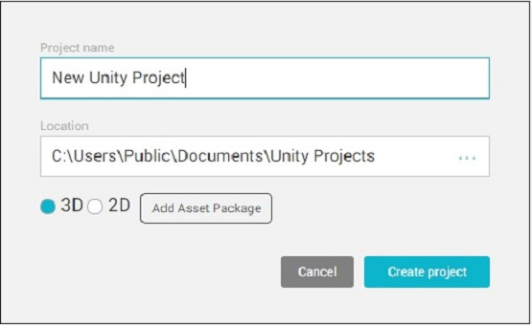
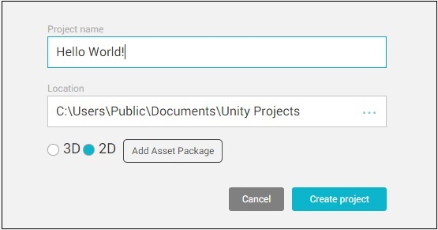
Creating your First Project:-

Slide 45
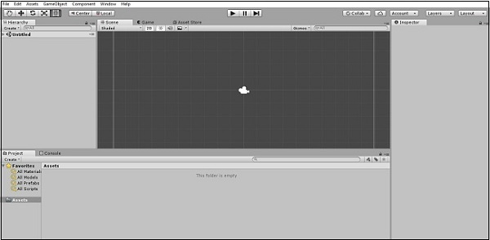
your new project is created and Unity opens, the following screen appears −

Slide 46
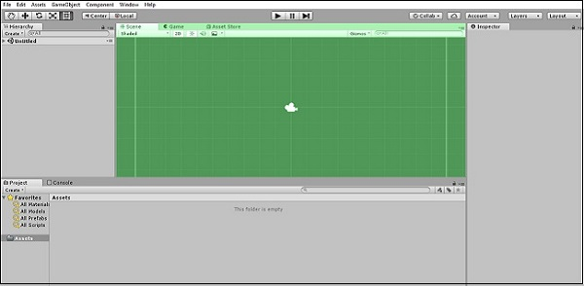
Let us have a quick run-through of what is visible in this window. For the time being, we are concerned with four main regions −

Slide 47
Creating Sprites:-
To create a sprite to your game, you must supply the engine with a texture. Let's create a texture first.
Get an image what you want to add as a sprite in standard image file such as PNG or JPG that you want to use,
Save it in your system directory and
Then drag the image into the Assets region of Unity.
Now drag the image from the Assets into the Scene Hierarchy.

Slide 48
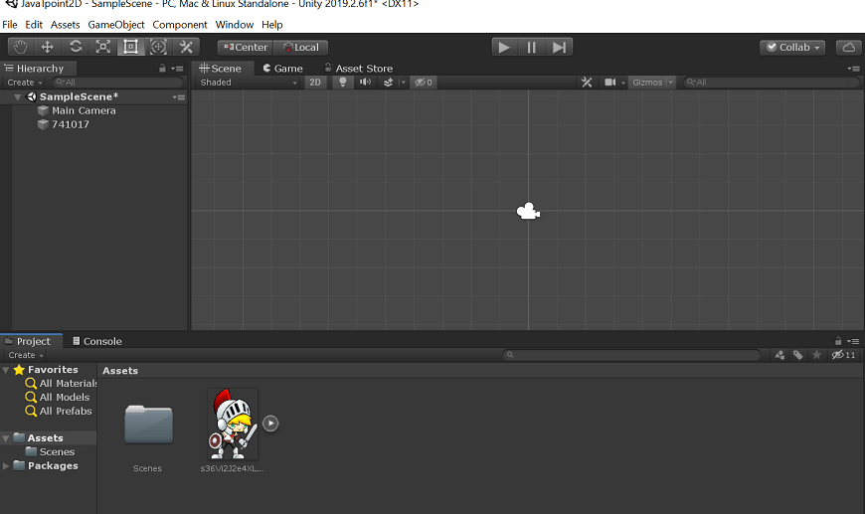
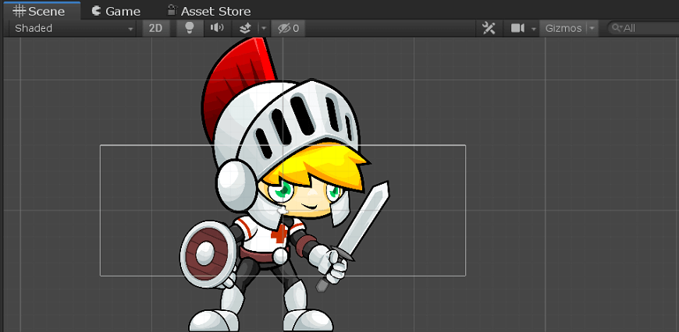

Slide 49
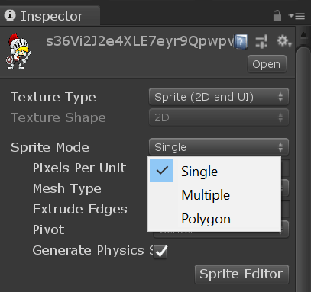
Sprite Modes:-

Slide 50

Modifying Sprites:-
1. first-Hand
2. Move tool.
3. Rotate tool
4. Scale tool
5. Rect tool.
6. Move, Rotate, and a Scale tool.
7. Custom Editor tool.

Slide 51
Scripting in Unity
Scripting is an essential ingredient in all applications you make in Unity.
Setting up scripting environment-
Setting up an IDE- so you can use your favourite code editor when working with unity.
Visual studio is installed by default when you install the unity.
To open scripts in VS Code, select it as the External Script Editor in the Editor Preferences (menu: Unity > Preferences > External Tools > External Script Editor).
Managed code debugging in Unity works on all platforms except WebGL.

Slide 52
Unit Testing-The Unity Test Framework package (formerly the “Unity Test Runner”) is a tool that allows you to test your code in both Edit mode and Play mode, and also on target platforms such as Standalone, Android, or iOS.
Automated testing helps you check that all parts of your code are functioning as expected. It saves time by identifying where and when problems occur as soon as they are introduced during development, rather than relying on manual testing.

Slide 53
Concepts-
Unity uses an implementation of the standard Mono runtime for scripting, it still has its own practices and techniques for accessing the engine from scripts.
Creating and Using Script:-
The behavior of GameObjects is controlled by the Components that are attached to them.
Unity allows you to create your own Components using scripts.
You can create a new script from the Create menu. Assets > Create > C# Script from the main menu.
Components often have properties that are editable in the inspector.
In C#, you must declare a variable as public to see it in the Inspector.

Slide 54
Event Function:-
Regular Update Events-
Update is called before the frame is rendered and also before animations are calculated.
A separate event function called FixedUpdate is called just before each physics update.
FixedUpdate functions have been called for all objects in the scene.
Initialization Events-
Start-The Start function is called before the first frame.
Awake-The Awake function is called for each object in the scene at the time when the scene loads.

Slide 55
GUI Events-
OnMouseOver,OnMouseDown-A set of OnMouse Functions is available to allow script to react to user actions with actions with the mouse.
OnGUI-The OnGUI () function gets called every frame as long as the containing script is enabled.
Physics Events-
The corresponding OnTriggerEnter, OnTriggerStay and OnTriggerExit functions will be called when the object’s collider is configured as a Trigger.
Coroutine-
a coroutine is a function that is capable of waiting and timing its process, as well as pausing it entirely.
It also needs a yield return statement.
WaitForSeconds class - This makes the coroutine wait for a certain amount of real-world seconds before continuing.
Coroutines are extensively used for timed methods. A coroutines also stops when the GameObject it is attached to is disabled with Sedative(false).

Slide 56
A namespace is simply a collection of classes that are referred to using a chosen prefix on the class name.
Attributes are markers that can be placed above a class, property or function in a script to indicate special behaviour.
Null Refrence Exceptions-
NullReferenceException happens when your script code tries to use a variable which isn’t set (referencing) and object.
The error message that appears tells you a great deal about where in the code the problem happens.

Slide 57
Plug-in-
The code created outside Unity in the form of a plug-in.
There are two kinds of plug-in-
Managed plug-ins are managed .NET assemblies created with tools like Visual Studio. They contain only .NET code which means that they can’t access any features that are not supported by the .NET libraries.
Native plug-ins are platform-specific native code libraries. They can access features like OS calls and third-party code libraries that would otherwise not be available to Unity.

Slide 58
Classes-
GameObject: Represents the type of objects which can exist in a Scene.
MonoBehavier: The base class from which every Unity script derives, by default.
Object: The base class for all objects that Unity can reference in the editor.
Transform: Provides you with a variety of ways to work with a GameObject’s position, rotation and scale via script, as well as its hierarchical relationship to parent and child GameObjects.
Vectors: Classes for expressing and manipulating 2D, 3D, and 4D points, lines and directions.
Quaternion: A class which represents an absolute or relative rotation, and provides methods for creating and manipulating them.
ScriptableObjects: A data container that you can use to save large amounts of data.

Slide 59
Time(and framerate management):The Time class allows you to measure and control time, and manage the framerate of your project.
Mathf: A collection of common math functions, including trigonometric, logarithmic, and other functions commonly required in games and app development.
Random: Provides you with easy ways of generating various commonly required types of random values.
Debug: Allows you to visualise information in the Editor that may help you understand or investigate what is going on in your project while it is running.
Gizmos and Handles: allows you to draw lines and shapes in the Scene view and Game view, as well as interactive handles and controls.

Slide 60
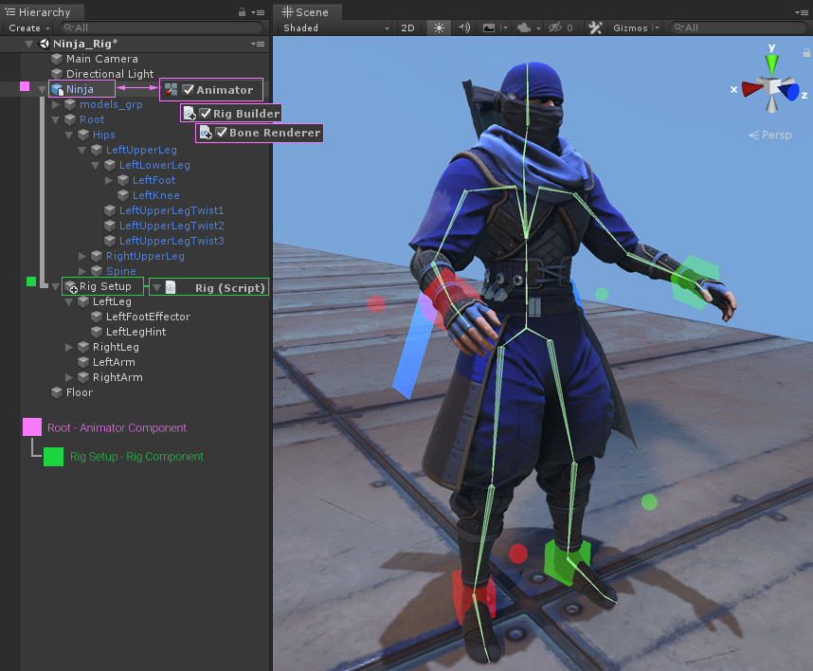
Animation
Unity’s Animation features include retargetable animations, full control of animation weights at runtime, event calling from within the animation playback, sophisticated state machine hierarchies and transitions, blend shapes for facial animations, and much more

Slide 61
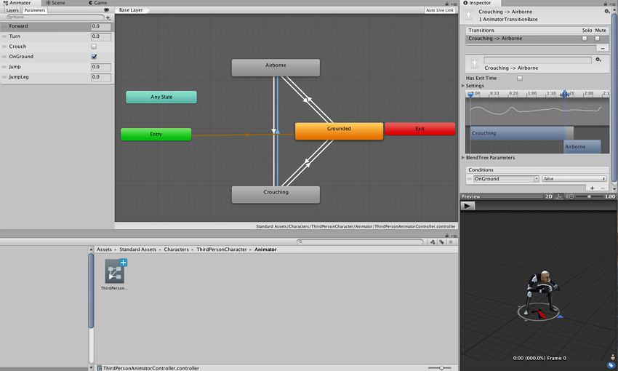
Typical view of an Animation State Machine in the Animator window

Slide 62
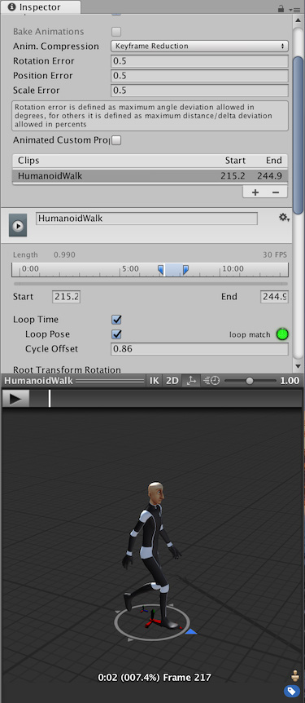
Animation workflow
Unity’s animation system is based on the concept of Animation Clips.
Support for imported animation clips and animation created within Unity.

Slide 63

Animation Created and Edited Within Unity

Slide 64

Animation Clips are then organised into a structured flowchart-like system called an Animator Controller.
Animator Controller might contain dozens of humanoid animations for all the main character’s actions, and might blend between multiple clips at the same time to provide a fluid motion as the player moves around the scene.
Animation system also has numerous special features for handling humanoid characters.
special features are enabled by Unity’s Avatar system, where humanoid characters are mapped to a common internal format.

Slide 65

Timeline

Slide 66
Unity's Timeline:-
Use Unity's Timeline to create cinematic content, game-play sequences, audio sequences, and complex particle effects.
Each cut-scene, cinematic, or game-play sequence that you create with Unity's Timeline consists of a Timeline Asset and a Timeline instance.
The Timeline window creates and modifies Timeline Assets and Timeline instances simultaneously.
The Timeline Overview section includes details on the relationship between the Timeline window, Timeline Assets, and Timeline instances.
The Using Timeline section shows how to create Timeline Assets and Timeline instances, record basic animation, animate humanoids, and use other Timeline features.
Installing Timeline:-
Timeline is a Package and is installed through the Packages window in Unity.

Slide 67
Multiplayer and Networking
There are two kinds of users for the Networking feature:
Users making a Multiplayer game with Unity. These users should start with the Network Manager or the High Level API.
Users building network infrastructure or advanced multiplayer games. These users should start with the NetworkTransport API.
High level scripting API-
Unity’s networking has a “high-level” scripting API (which we’ll refer to as the HLAPIThe HLAPI allows you to:
Control the networked state of the game using a “Network Manager”.
Operate “client hosted” games, where the host is also a player client.
Send and receive network messages.
Send networked commands from clients to servers.
Make remote procedure calls (RPCs) from servers to clients.
Send networked events from servers to clients.

Slide 68
Engine and Editor integration
Unity’s networking is integrated into the engine and the editor, allowing you to work with components and visual aids to build your multiplayer game. It provides:
A Network Identity component for networked objects.
A Network Behaviour for networked scripts.
Configurable automatic synchronization of object transforms.
Automatic synchronization of script variables.
Support for placing networked objects in Unity scenes.

Slide 69
Setting up a multiplayer project
A Network Manager
A user interface (for players to find and join games)
Networked Player Prefabs (for players to control)
Scripts and GameObjects which are multiplayer-aware
important concepts to understand and make choices about when building your game.
The relationship between a client, a server, and a host
The idea of authority over GameObjects and actions
The Network Manager
Unity’s built-in Network Manager component wraps up all of the features for managing your multiplayer game into one single component.
A user interface for players to find and join games
Almost every multiplayer game provides players with a way to discover, create, and join individual game “instances” (also known as “matches”).

Slide 70

Unity has an extremely basic built-in version of such an interface, called the NetworkManagerHUD.
It can be extremely useful in the early stages of creating your game, because it allows you to easily create matches and test your game without needing to implement your own UI.
To start using the Network Manager HUD, create an empty GameObject in your Scene.
he Network Manager HUD has two basic modes: LAN (Local Area Network) mode and Matchmaker mode.
LAN mode is for creating or joining games hosted on a local area network (that is, multiple computers connected to the same network).
Matchmaker mode is for creating, finding and joining games across the internet (multiple computers connected to separate networks).

Slide 71

Server and Host-
A server is an instance of the game which all other players connect to when they want to play together.
Clients are instances of the game that usually connect from different computers to the server. Clients can connect over a local network, or online.

Slide 72
When you are making your multipayer game, you will need to implement a way for players to find each other, join existing matches or create new ones.
The important parts of your game is given below-
Host migration, for when the player hosting a peer-hosted game quits.
Network discovery, to help your players connect to each other on a LAN
Multiplayer lobby, to help your players create or join matches across the internet
Custom network client and server code - when you have custom requirements and want to write your own connection code rather than using Unity’s Network Manager.

Slide 73

Setting up Unity Multiplayer-
open the Services window by selecting Window > General > Services in the menu bar and select Multiplayer.

Slide 74



Slide 75
UnityWebRequest provides a modular system for composing HTTP requests and handling HTTP responses.
The primary goal of the UnityWebRequest system is to allow Unity games to interact with web browser back-ends.
Architecture-
The UnityWebRequest ecosystem breaks down an HTTP transaction into three distinct operations:
Supplying data to the server
Receiving data from the server
HTTP flow control (for example, redirects and error handling)

Slide 76

XR or Extended Reality
Extended Reality, is a combination of the real and virtual worlds and human-machine interaction. XR is an umbrella term encapsulating Augmented Reality (AR), Virtual Reality (VR), mixed reality (MR), and everything in between.

Slide 77
Virtual Reality(VR): is a simulated experience that can be similar to or completely different from the real world.
The application simulates a completely different environment around the user.
Mixed Reality (MR): is a blend of physical and digital worlds, unlocking the links between human, computer, and environment interaction.
This new reality is based on advancements in computer vision, graphical processing power, display technology, and input
systems.
The application combines its own environment with the user’s real-world environment and allows them to interact with each other.
Augmented Reality (AR): is an interactive experience of a real-world environment where the objects that reside in the real world are enhanced by computer-generated perceptual information, sometimes across multiple sensory modalities, including visual, auditory, haptic, somatosensory and olfactory.
The application layers content over a digital view of the real world.

Slide 78

XR or Extended Reality

Slide 79
Unity officially supports these platforms for XR:
ARKit
ARCore
Microsoft HoloLens
Windows Mixed Reality
Magic Leap
Oculus
PlayStation VR

Slide 80

Unity XR SDK
The Unity XR SDK is aimed at specialist users who want to develop their own XR providers that work with Unity.
The XR SDK package allows multiple backends (called “providers”) to implement a single engine feature (called a “subsystem”) in Unity.
Subsystems:-
A single subsystem consists of:
A developer-facing C# interface
A native interface that multiple backends (Providers) implement via dynamic libraries
Common engine code which handles communicating with the C# interface, the native interface, and the rest of the engine
XR provider is part of a Unity project and minimally consists of a manifest file and one or more native plug-ins.

Slide 81

Publishing
Unity includes a built-in publishing feature that allows you to publish to various popular platforms in an easy and efficient way.
You can publish the same application to multiple platforms, provided the application design takes into account each platform’s unique hardware and software requirements.

